Slide 1
Halimah’s Paintings
Watercolors from 2008 to 2019

Slide 2
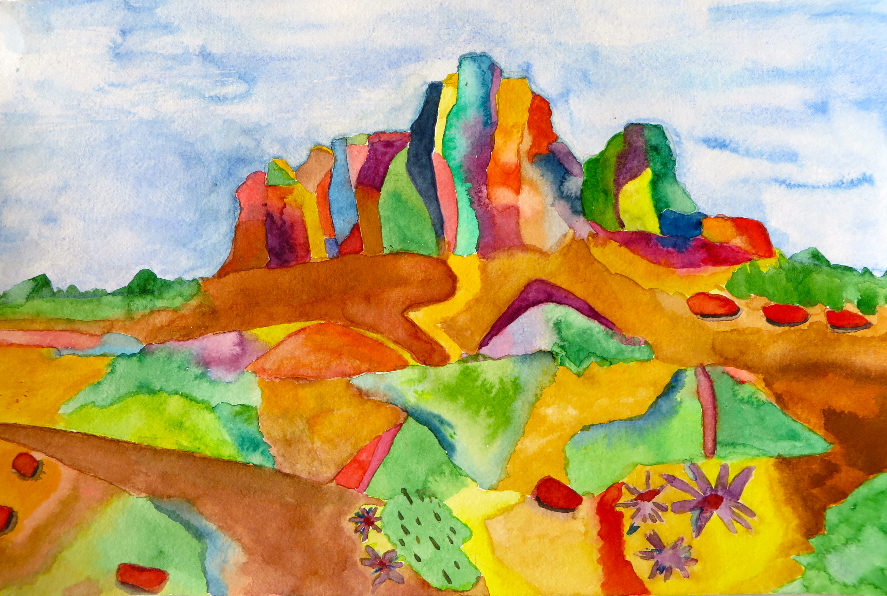
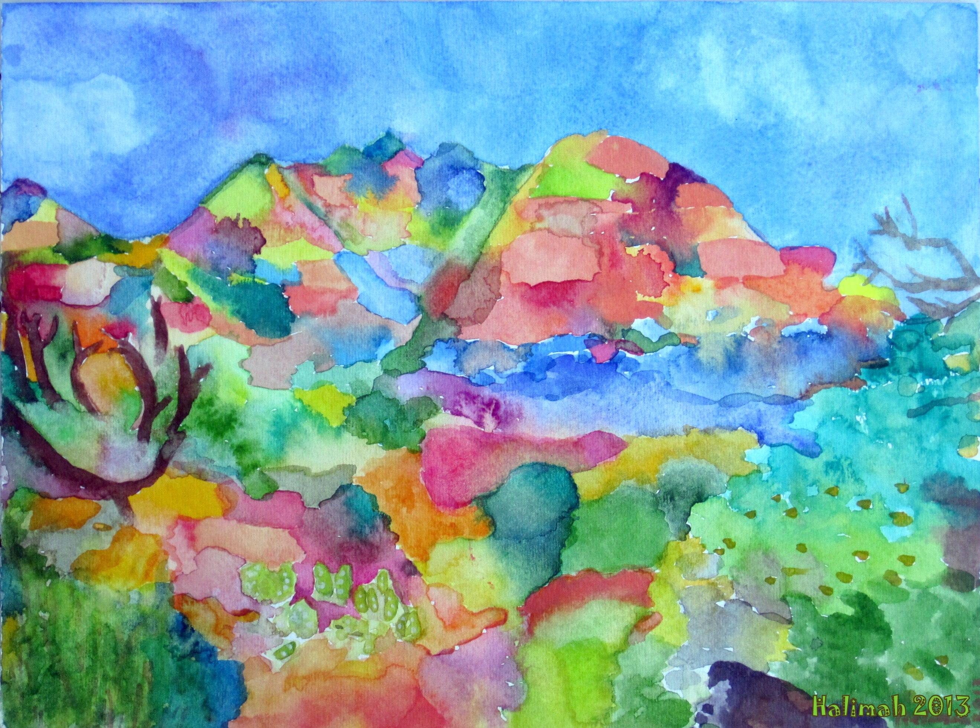
Sedona Watercolors
Sedona vista 10 x13”
Bell Rock in Sedona 10 x13”

Slide 3
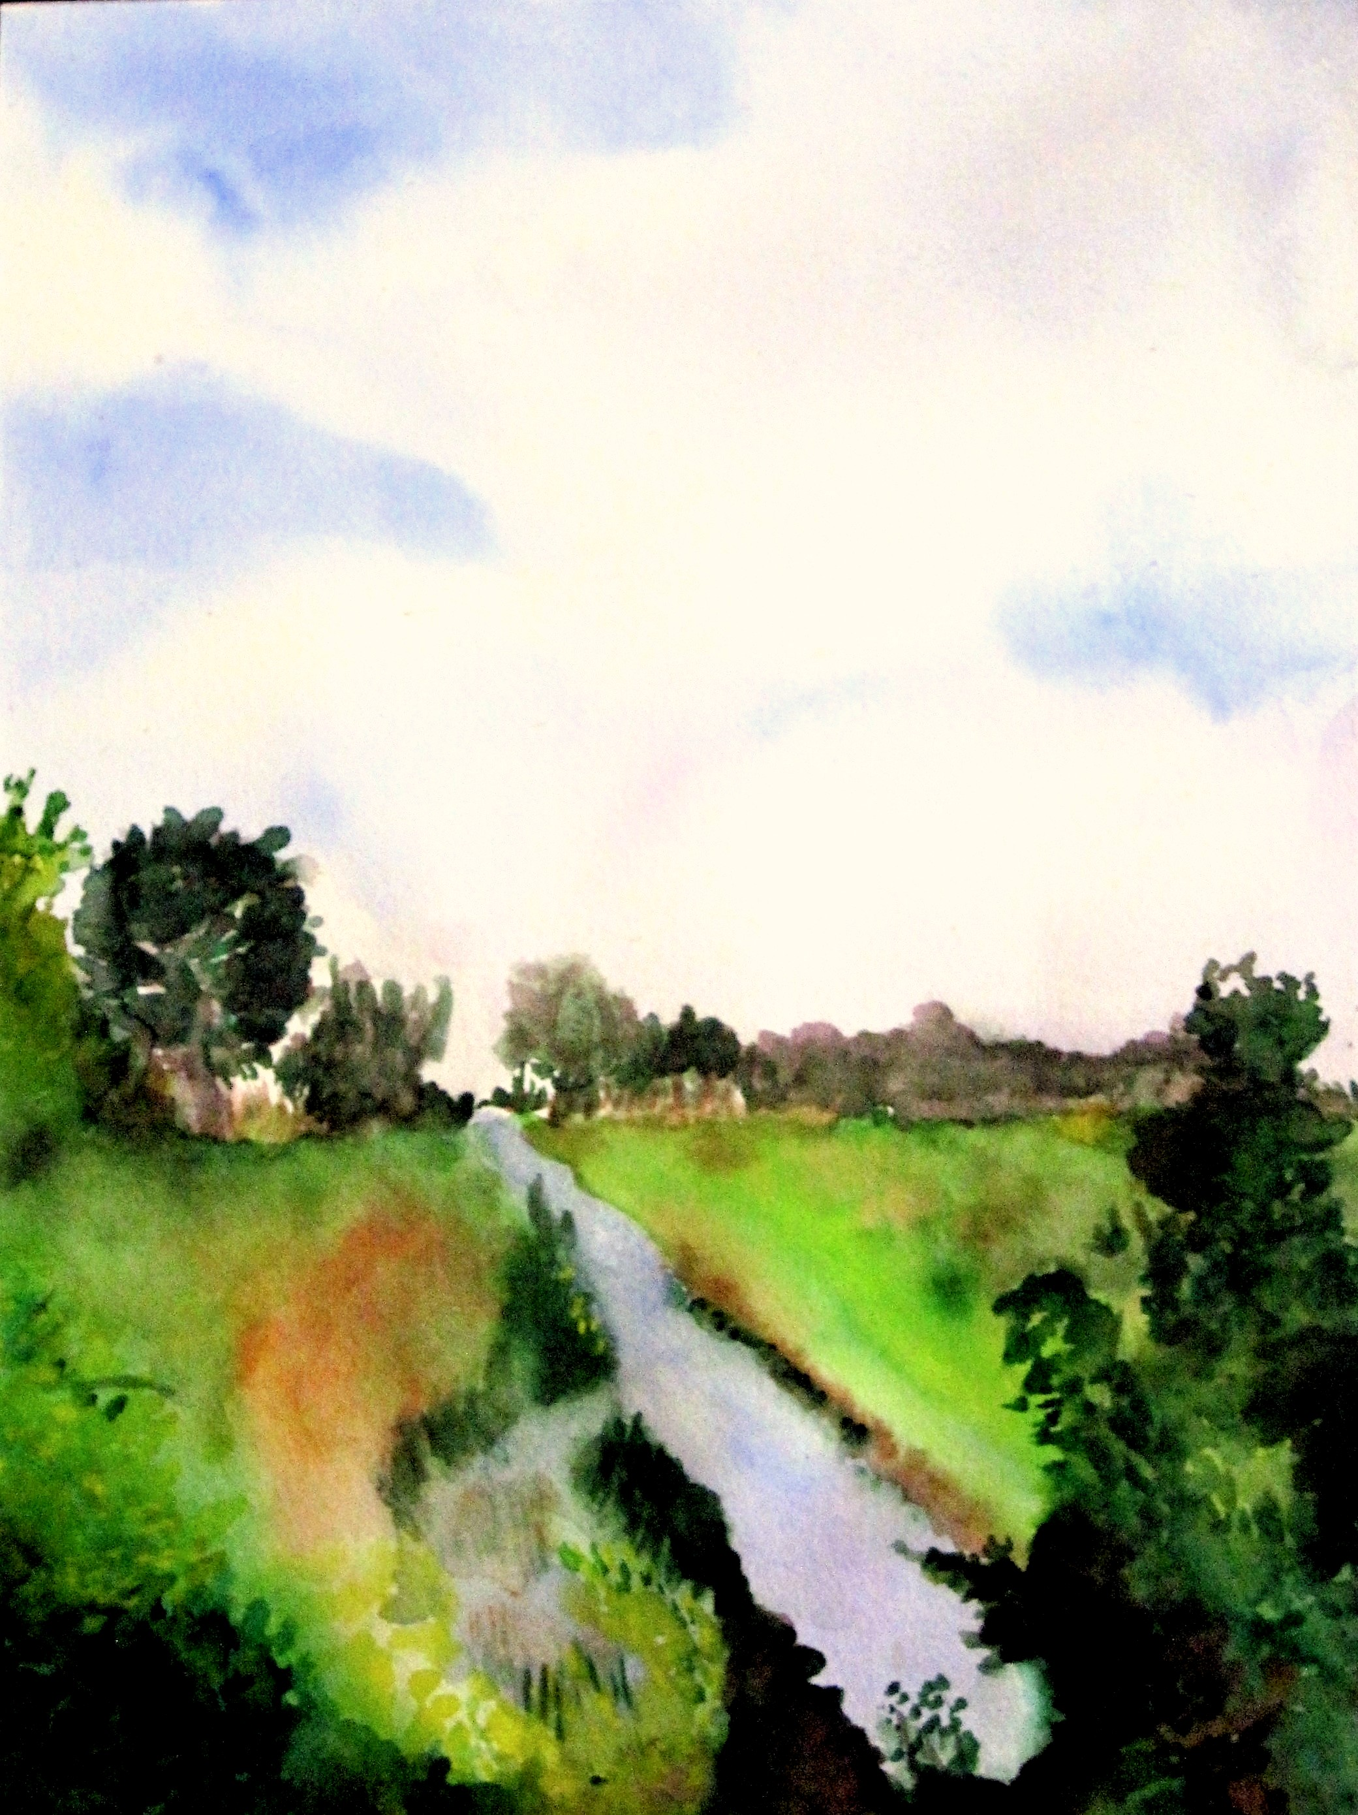
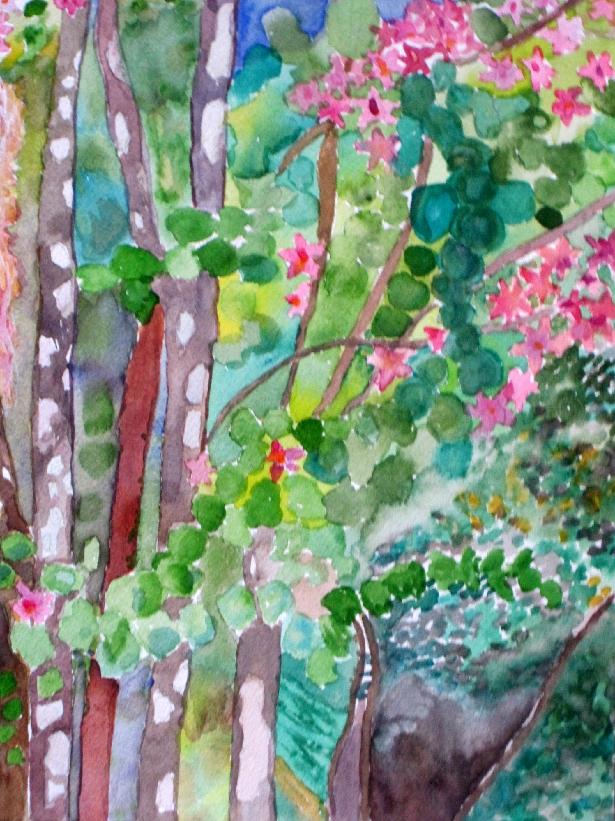
Old Florida Scenes
Alva Beauty 10 x13”
Loxahatchee Afternoon 12 x16”

Slide 4
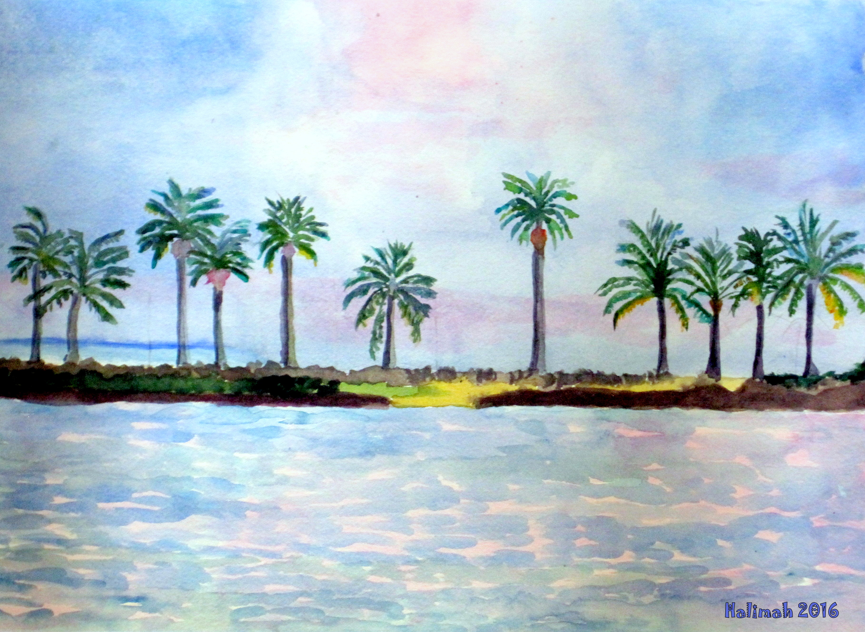
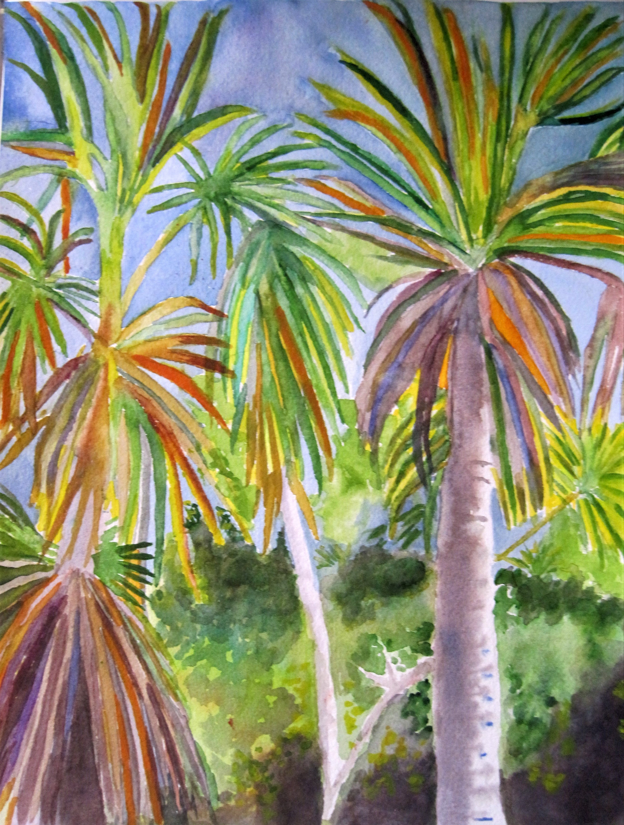
Florida Scenes
Matheson Hammock, a swimming cove from childhood 10 x13”
Las Tres Palmeras 10 x13”

Slide 5
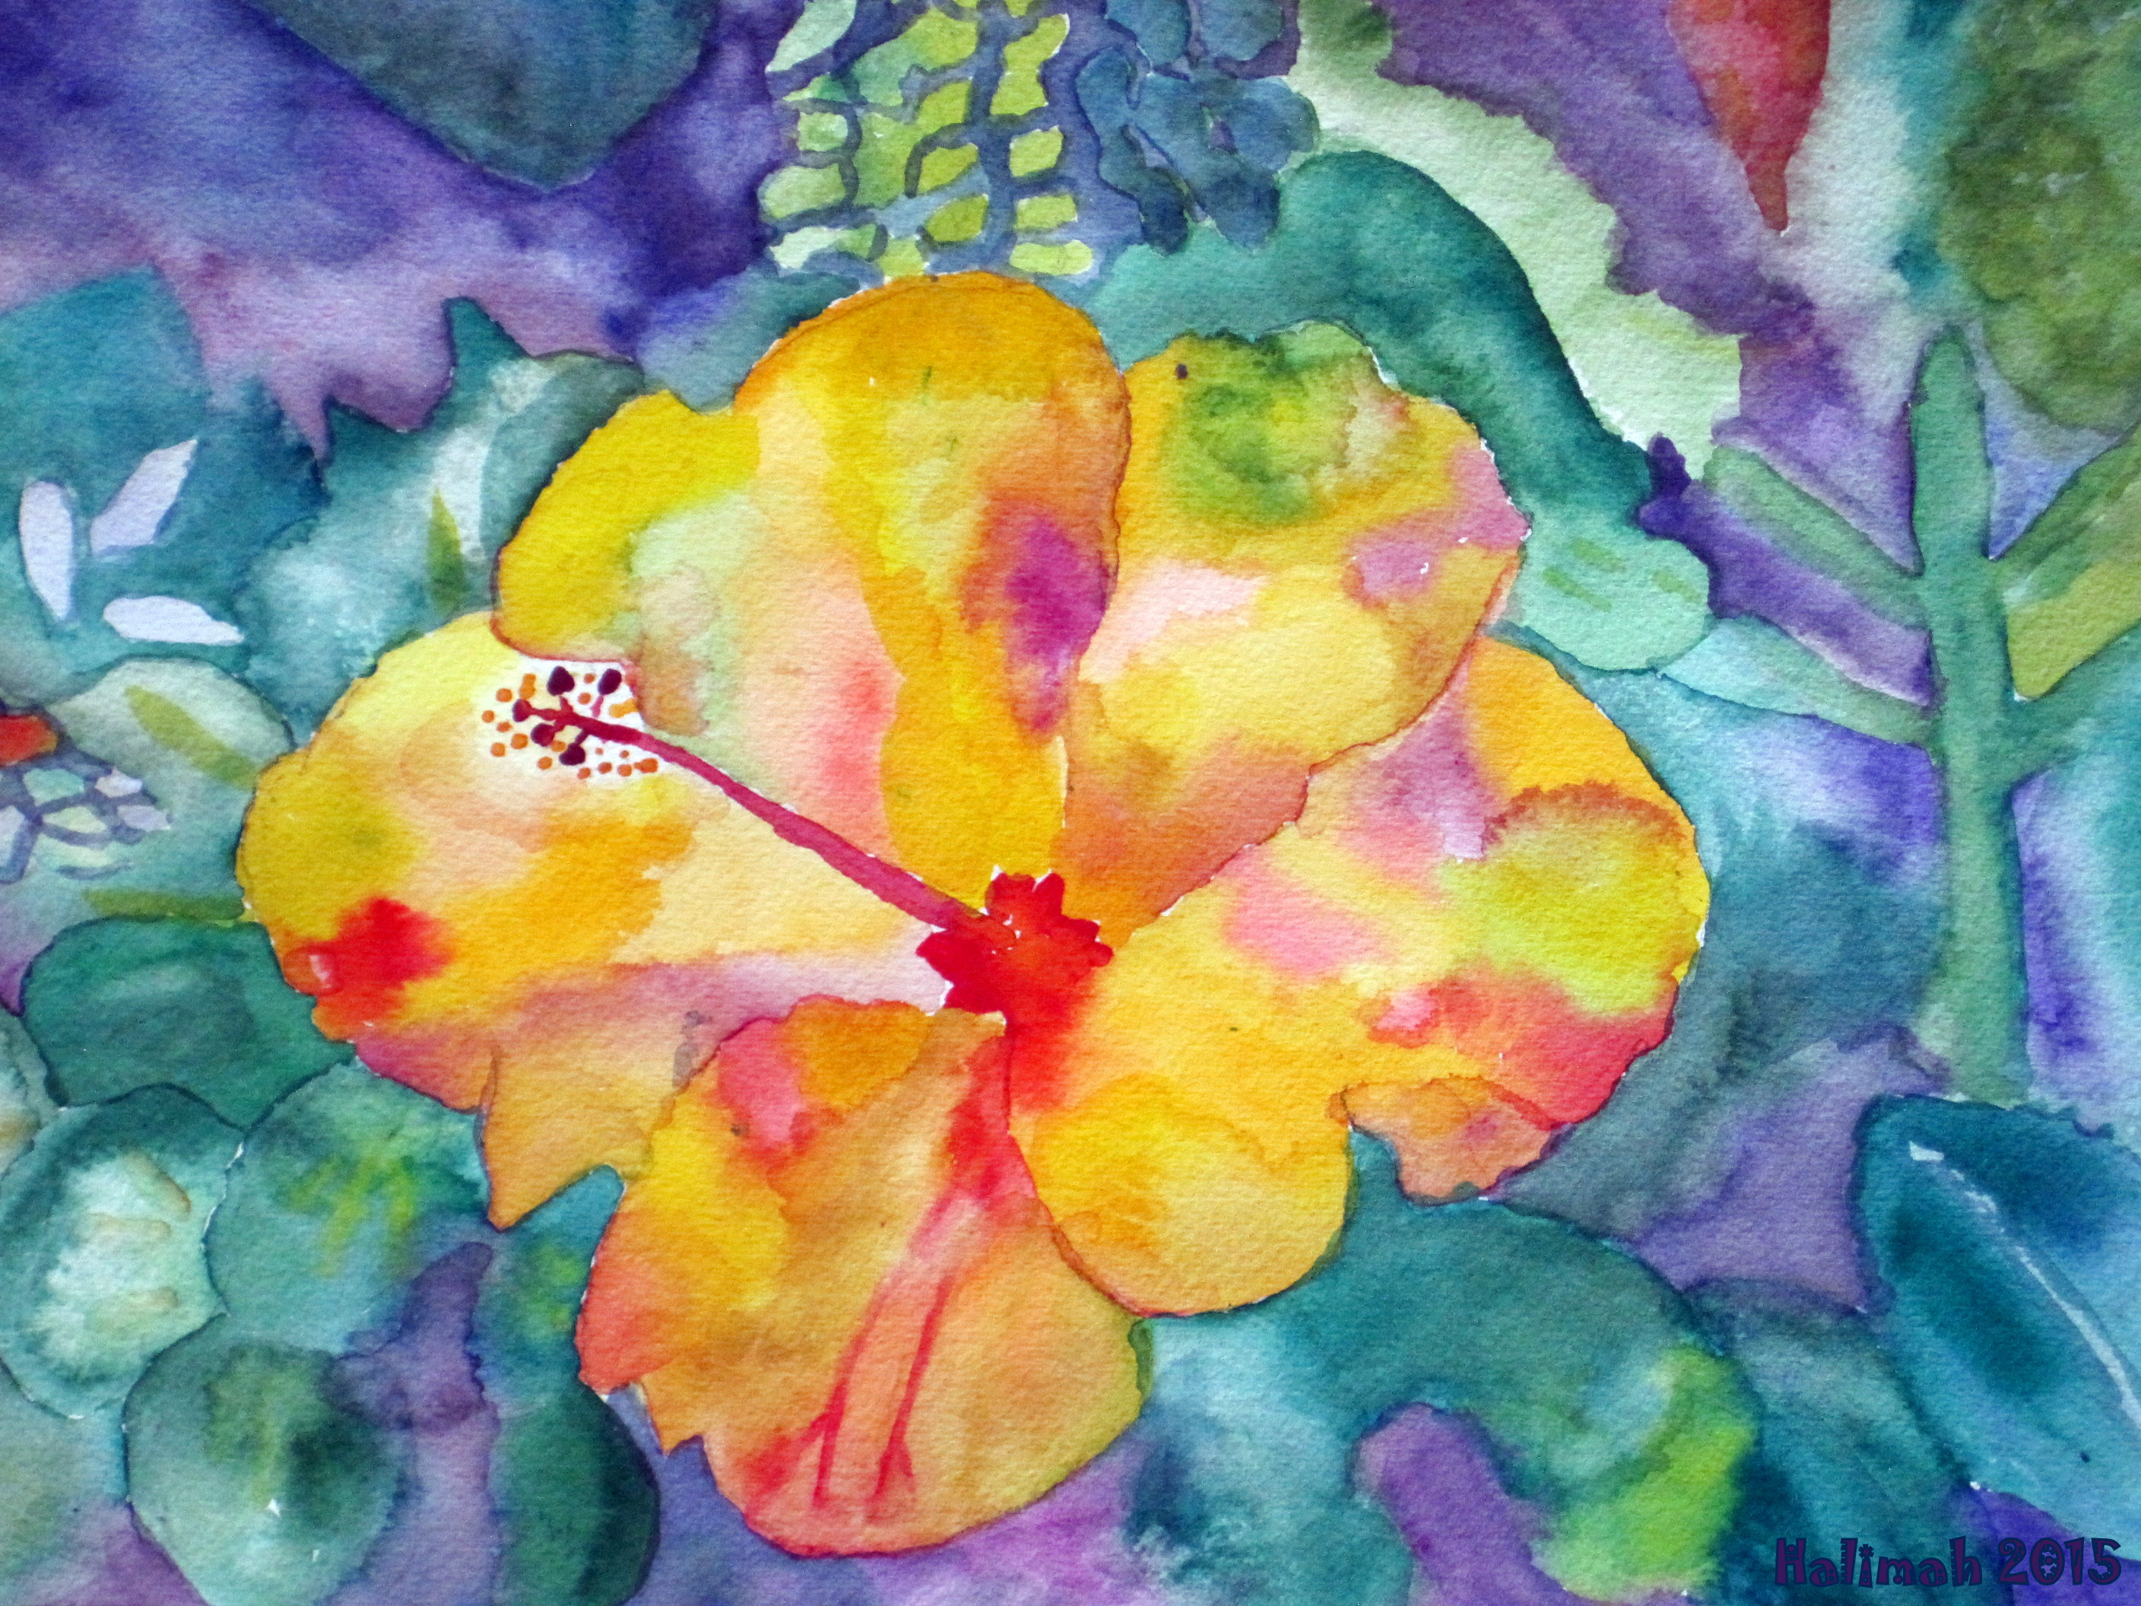
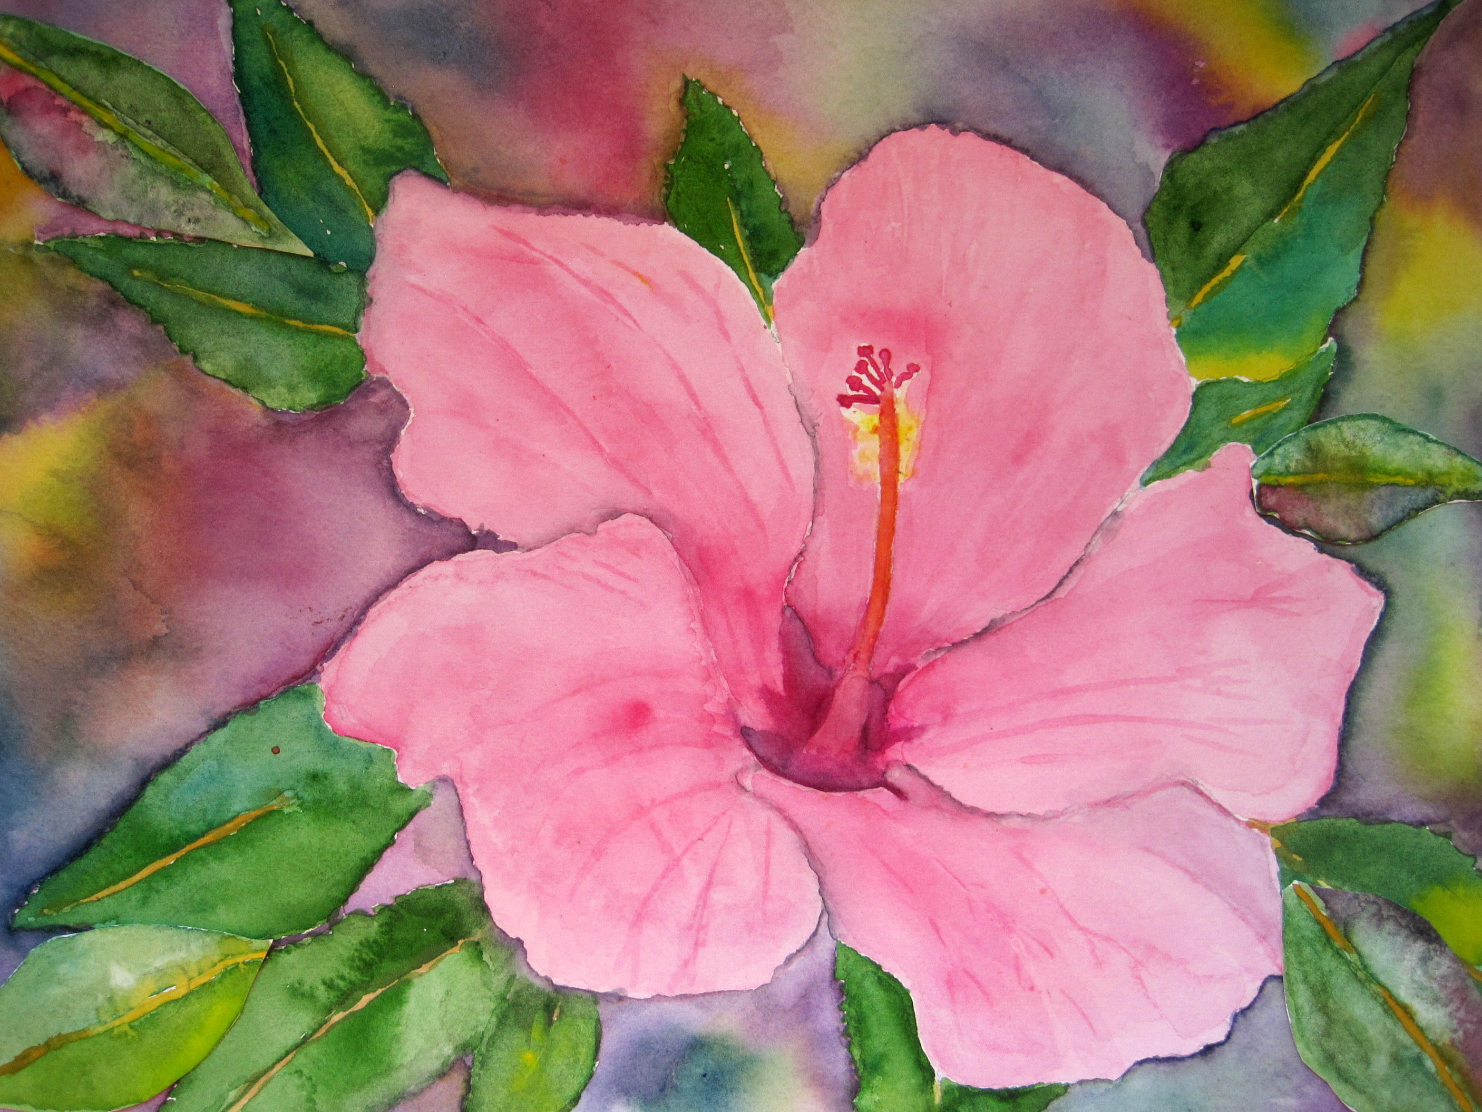
The Hibiscus Series…
The Multicolored Hibiscus
10 x14”
The Mariama Hibiscus 10 x14”

Slide 6
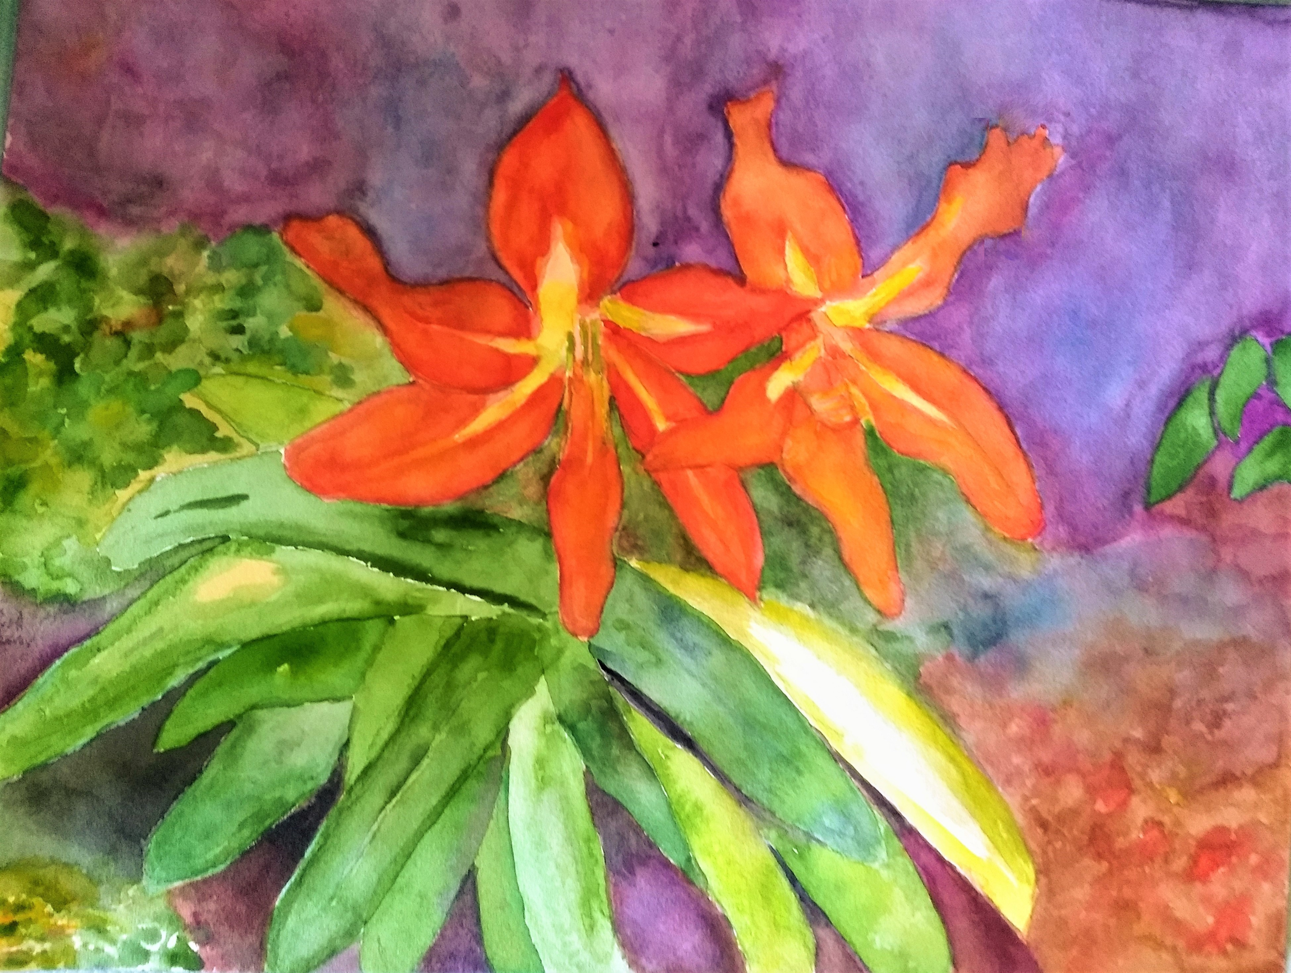
Meet the Happy Couple

Slide 7
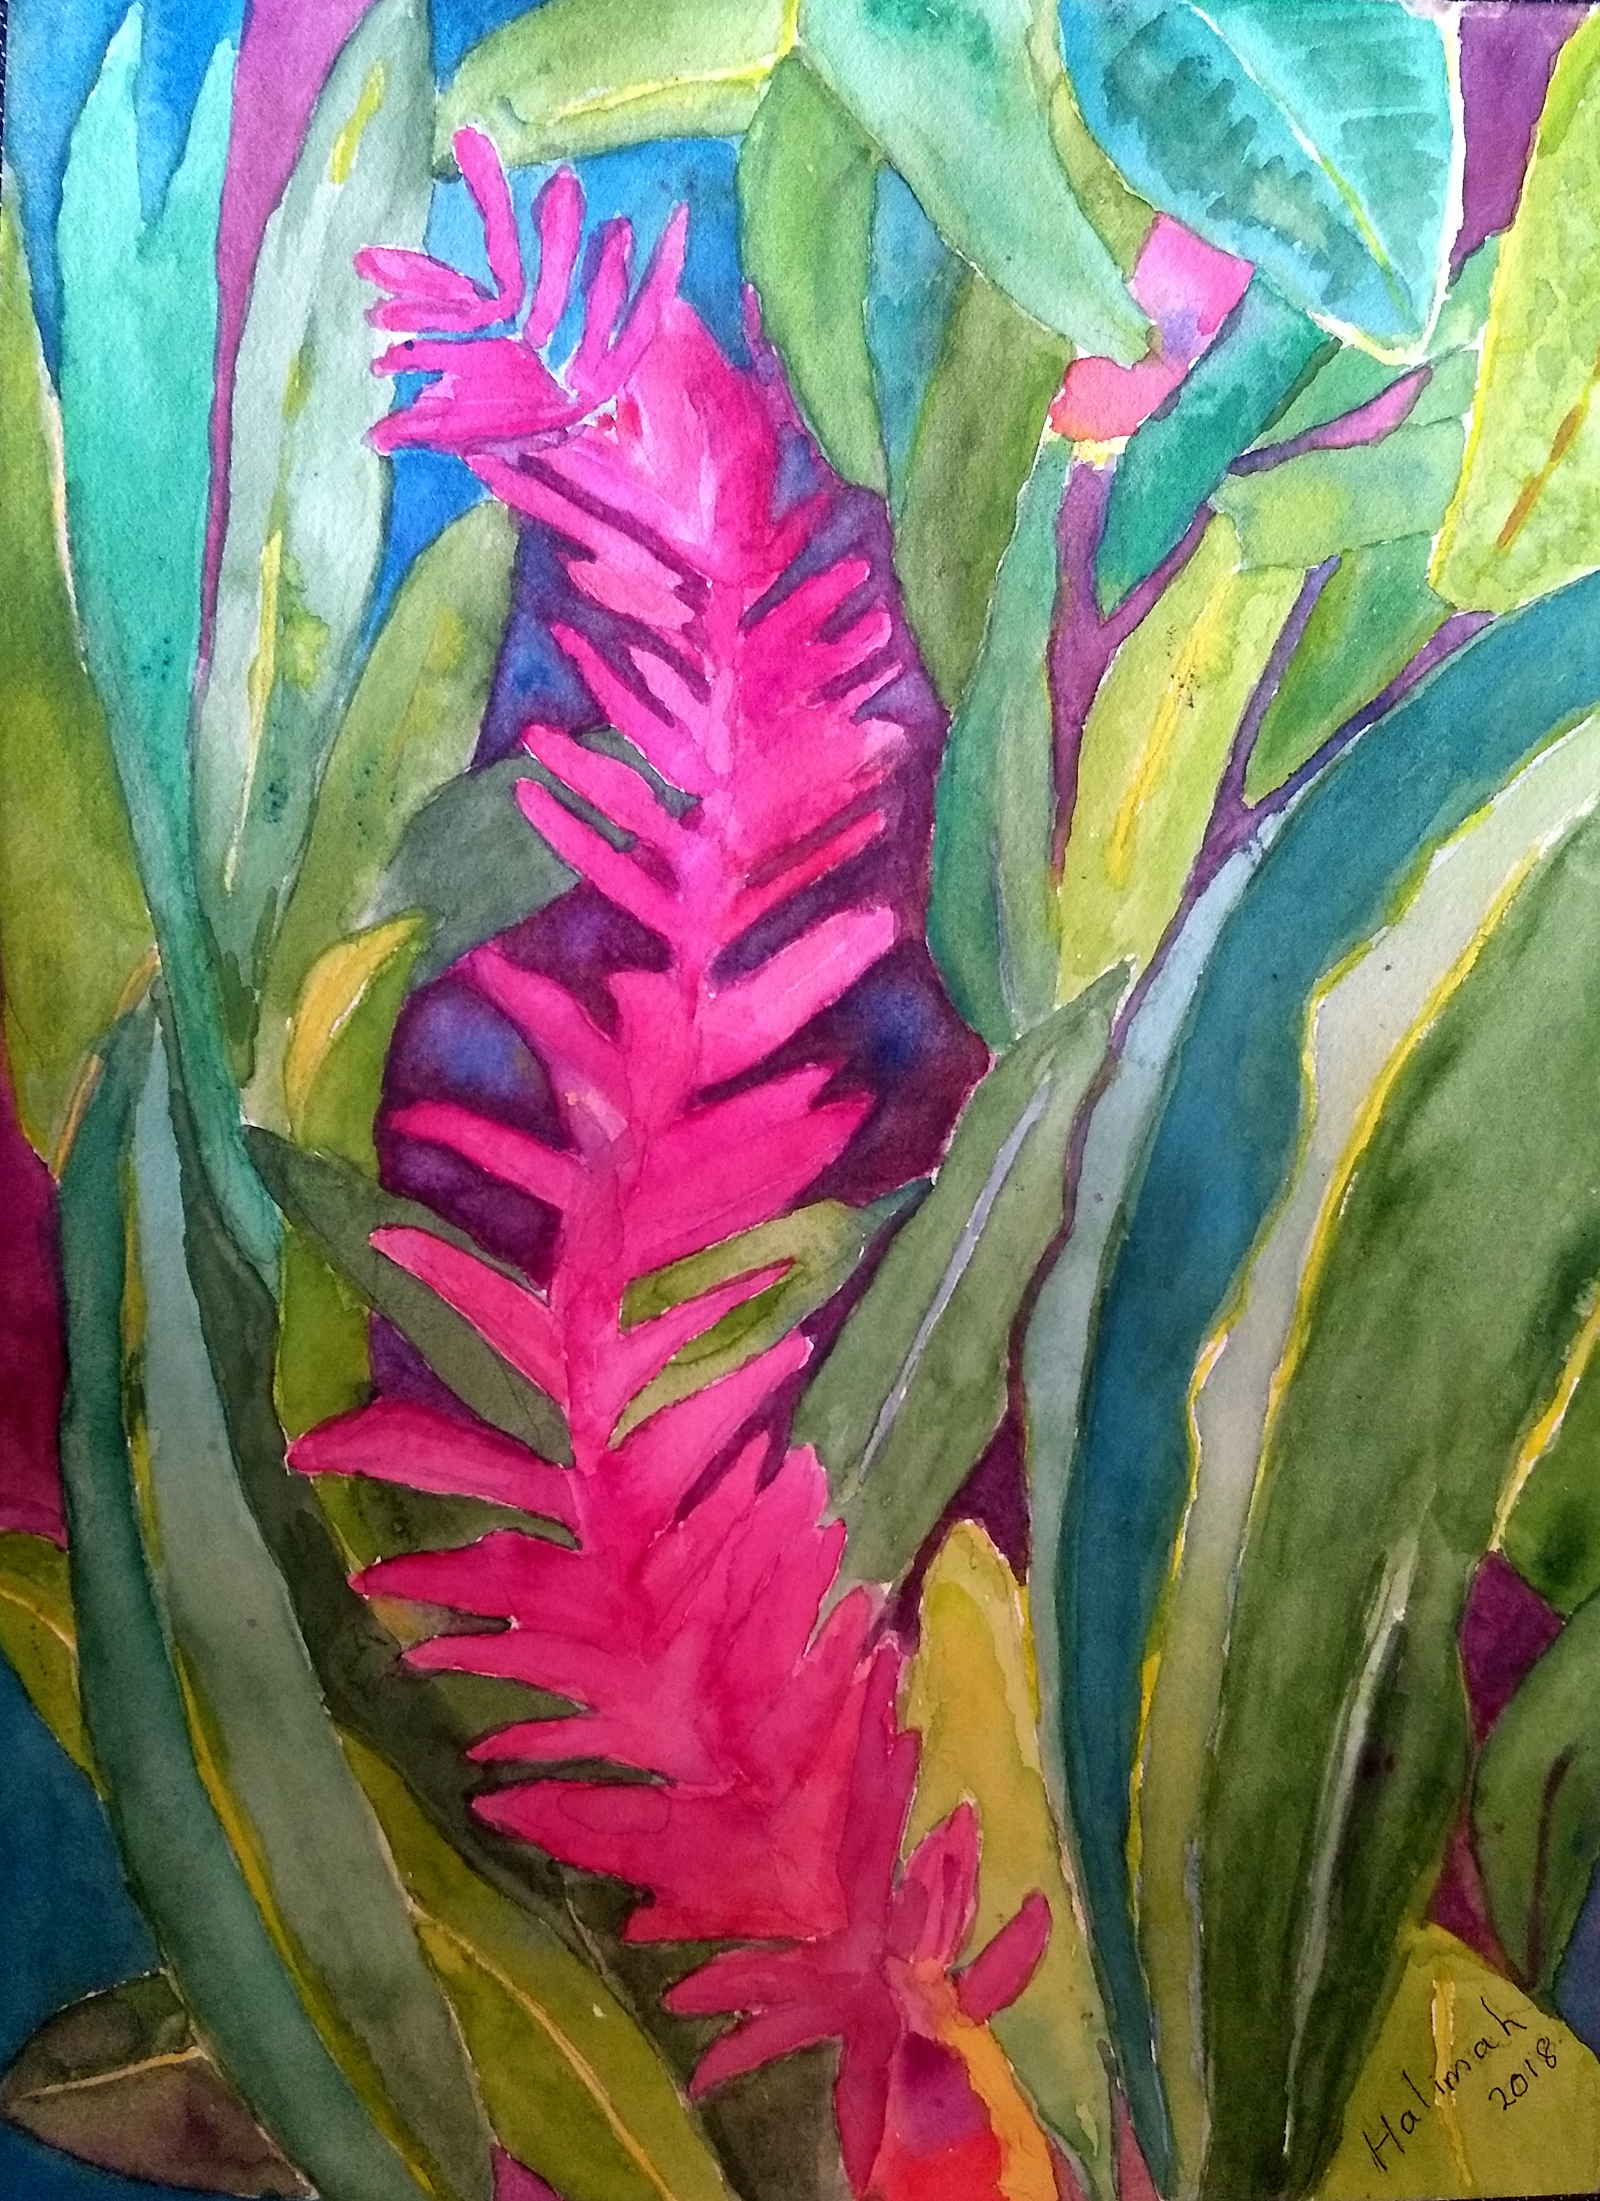
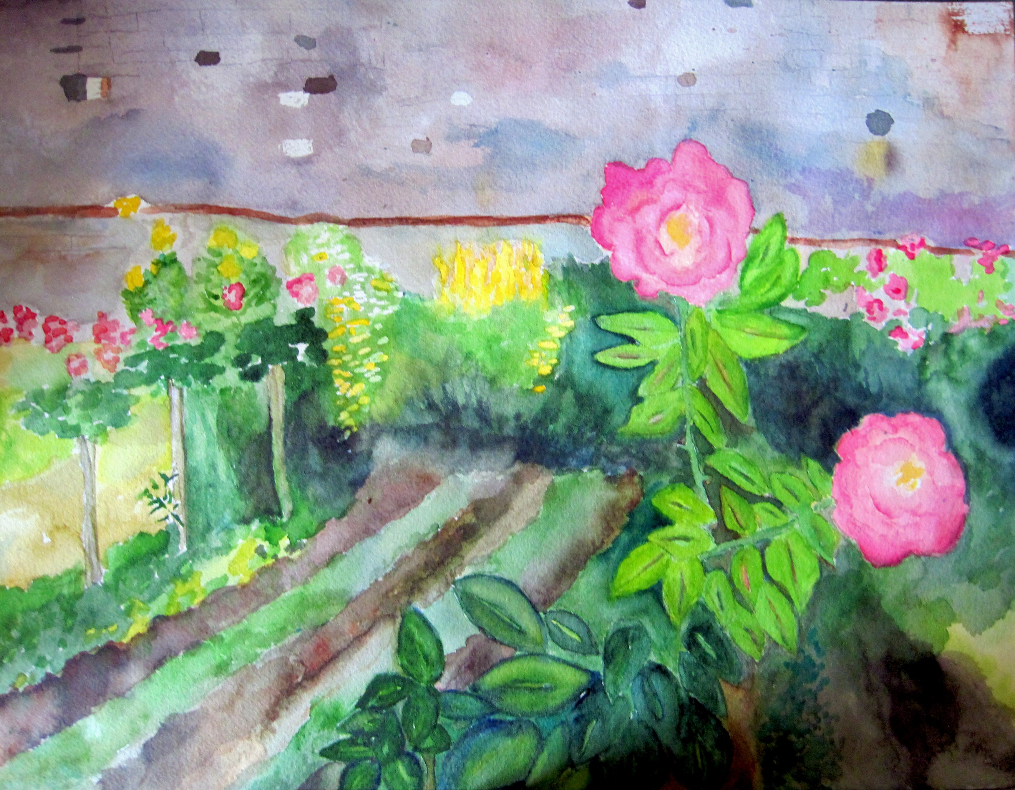
Travels with Halimah
Rose Garden at the Alhambra, Spain 12 x16”
Hawaiian Ginger in Oahu 10 x 14”

Slide 8
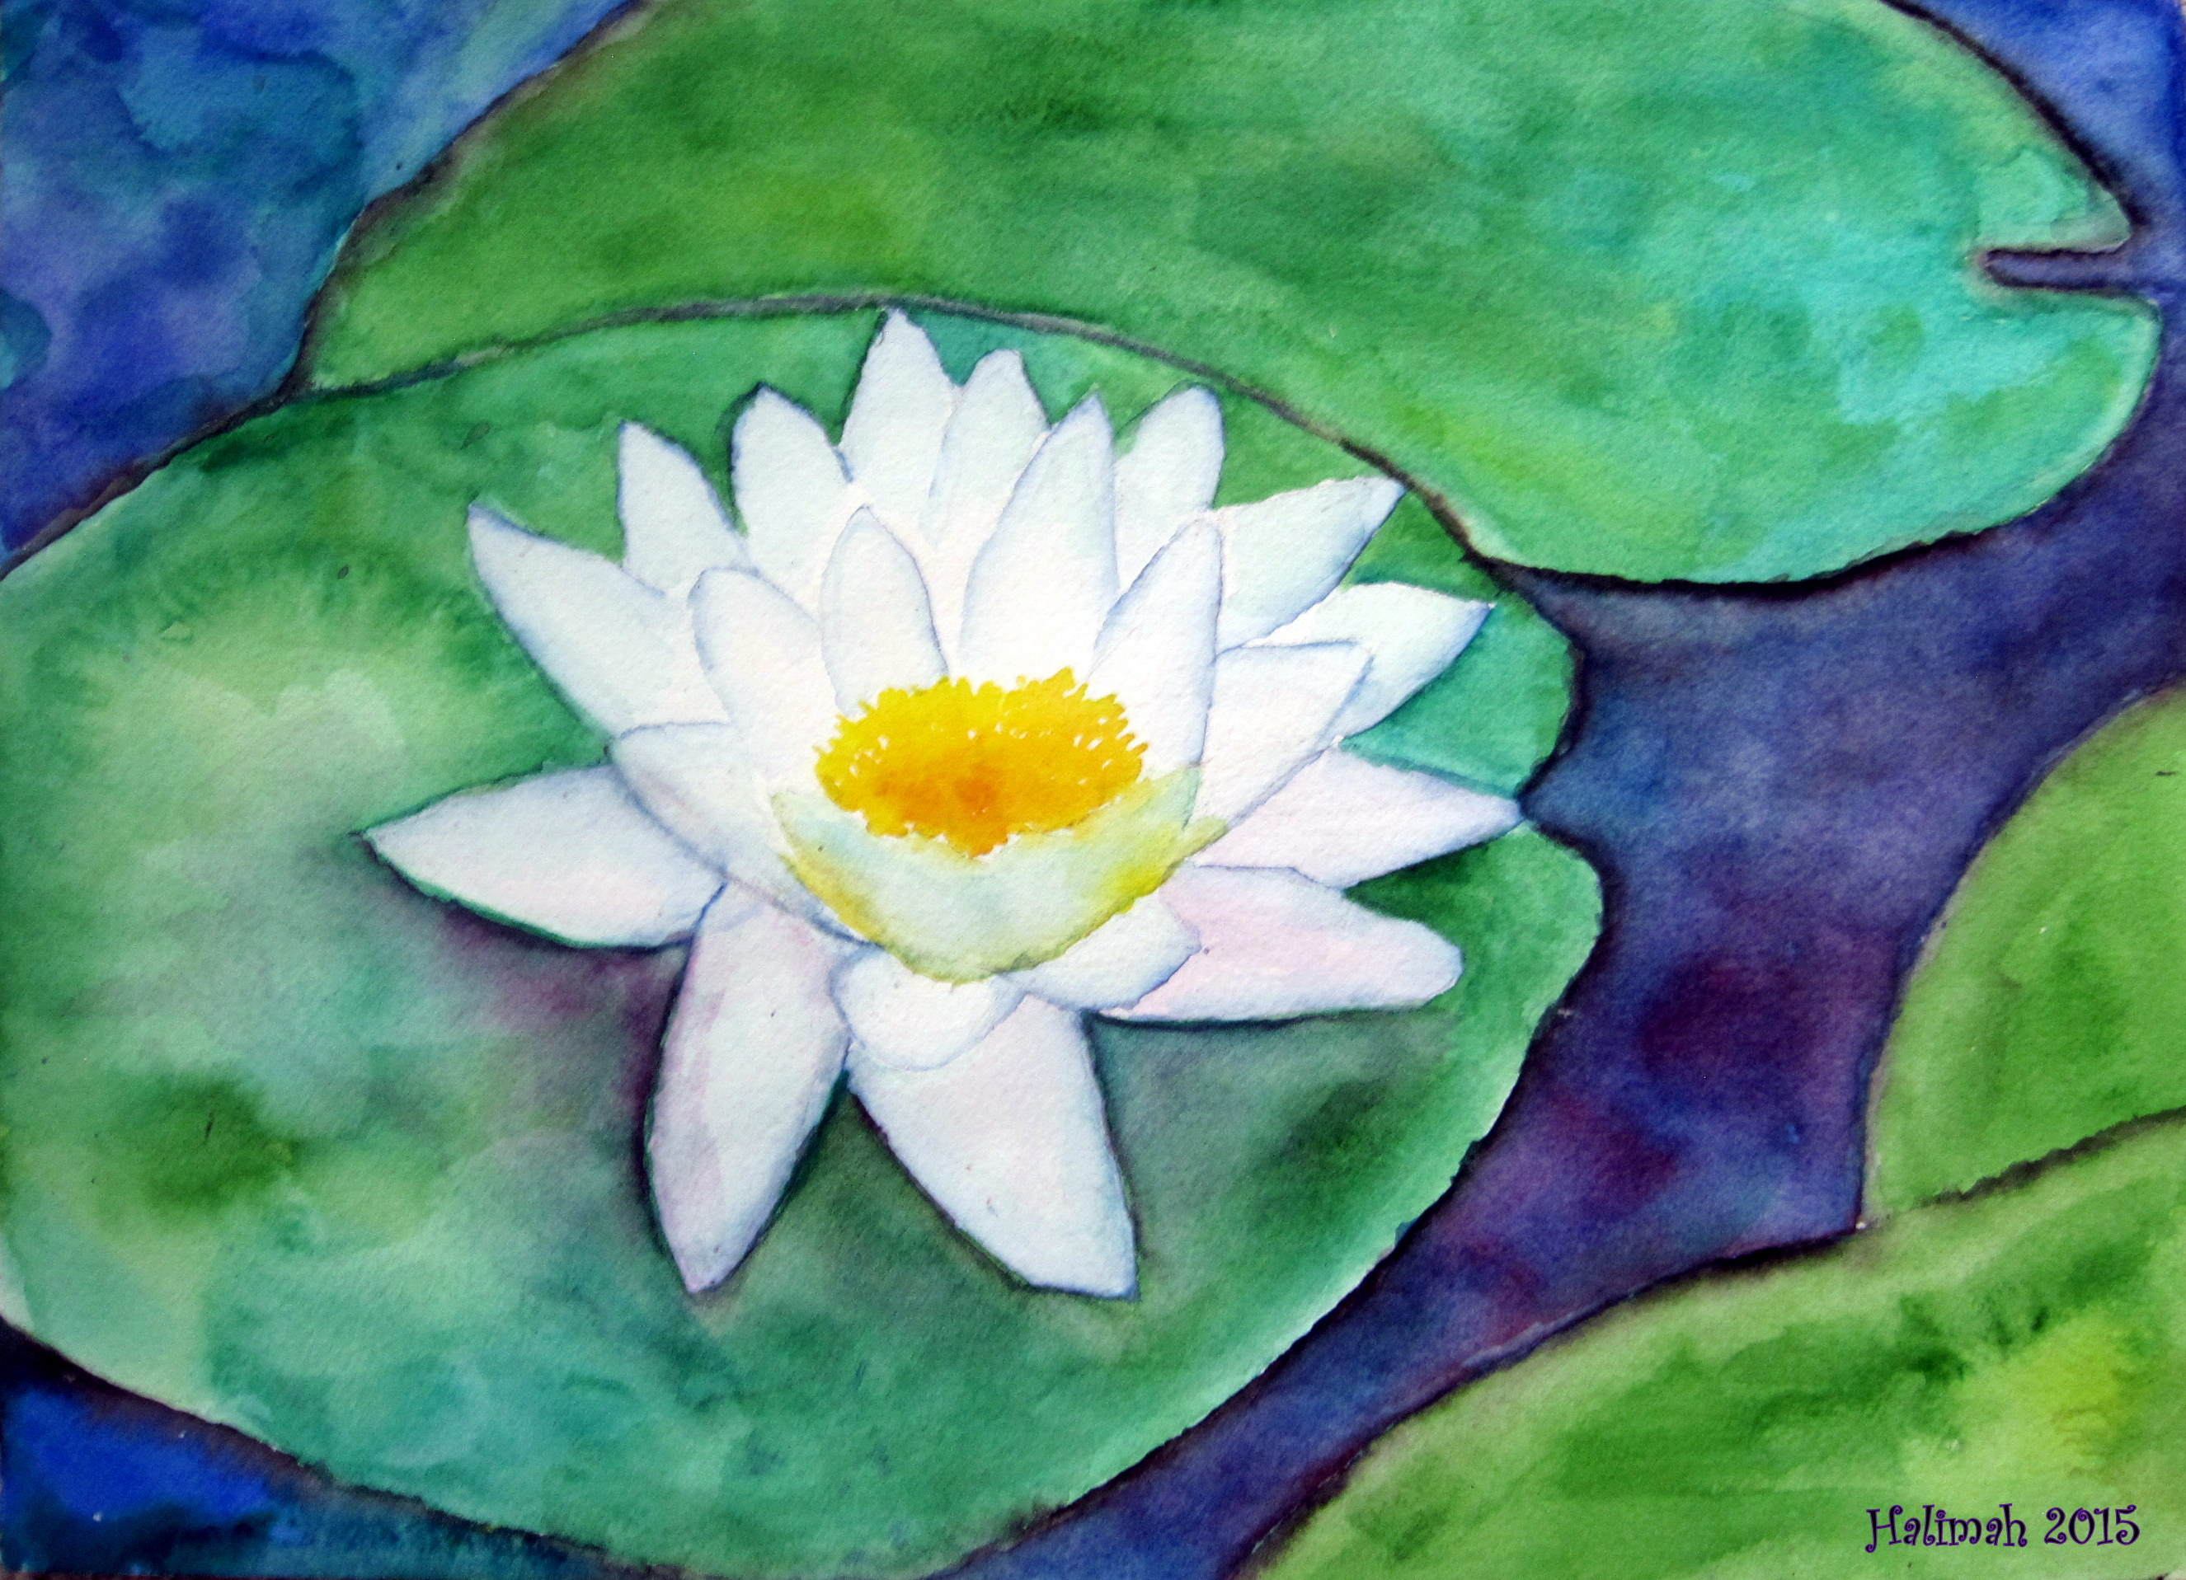
The Peace Lotus 12 x 16”

Slide 9
Las Tres Palmeras
Palm fronds standing on end wild with golden joy.
Small birds, lizards, and caterpillars (even iguanas) take cover amidst the orange, gold and purple leaves
Dreaming up small dwellings nestled behind the hula-skirted grass trunks.
Can you imagine the sparrows flitting about?
A stillness abides within this stand of palms
And if you’re here for even a bit, time might seem to stop altogether.
This a place that can remind us to pray.
-- a place to pray for peace in our hearts.
-- a place to pray for more love in our lives
Here we might entreat the universe for a grand reconciliación.
What is your prayer?

